Slide 1
Mining Flipping Correlations from large datasets with taxonomies
Marina Barsky, Sangkyum Kim,
Tim Weninger, Jiawei Han
VLDB 2012
Dept of computer science
Univ of illinois at urbana-champaign
Notes:
Today I will be presenting a paper about flipping correlation patterns

Slide 2
Outline
Challenge: strong correlations with low support
Flipping correlation patterns
Algorithm for mining flipping correlations
Performance
Real flipping patterns
Conclusion and future work
Notes:
In this paper we introduce a new type of pattern – a flipping
correlation pattern. The flipping patterns are obtained from
contrasting the correlations between items at different levels
of abstraction. They represent surprising correlations,
both positive and negative, which are specific for a given
abstraction level, and which “flip” from positive to negative
and vice versa when items are generalized to a higher
level of abstraction.

Slide 3
Correlations and frequent itemsets
Once all frequent itemsets are enumerated, we can find correlation between items in these frequent itemsets
Computation of frequent itemsets is feasible only for high support thresholds
Top-frequent itemsets often represent obvious relationships between items
Notes:
Though very frequent itemsets can be efficiently mined due
to the anti-monotonicity of support, an efficient algorithm
for computing positively or negatively correlated items with
low support is a challenge.
We are interested in low-support correlations, since very frequent itemsets often represent trivial knowledge

Slide 4
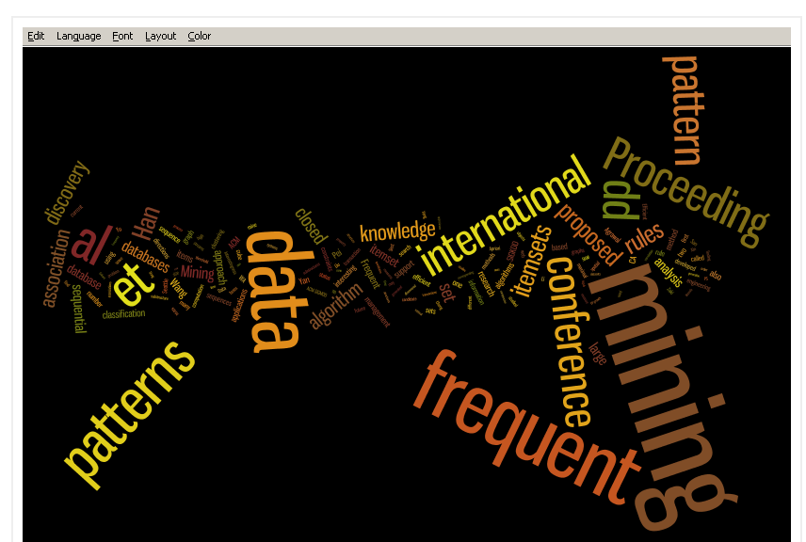
Example: frequent items in papers on frequent pattern mining
Notes:
For example, if we want to find correlated words in data mining papers. We observe that top frequent items do not represent a new interesting information, and we want to lower the support threshold

Slide 5
Challenge of finding itemsets with low support
In large datasets we can find the top most frequent itemsets
When we lower the support threshold, the number of frequent itemsets becomes big
How big? Very big: that we cannot keep in memory all different 2-item combinations, to update their counters
Notes:
However, lowering support threshold leads to an exponential explosion of the number of frequent patterns, and the computation becomes infeasible.

Slide 6
How can we discover non-trivial correlations in large datasets?
Instead of computing top-frequent, compute top-correlated patterns directly, without enumerating all frequent itemsets
This presents computational challenges
Some progress in this direction is in our previous paper
Sangkyum Kim et al., ECML/PKDD (2) 2011: 177-192
Notes:
A possible solution: compute correlations directly, without enumerating all frequent itemsets first. Some progress in this direction was made in our previous paper. With our new techniques, we can compute positive correlations directly.

Slide 7
Negative correlations
What if we are also interested in items that rarely appear in the same transaction?
The negative correlations can be useful:
  To identify competing items: absence of Blu ray and DVD player in the same transaction
  To discover underrepresented topic combinations: in DBLP –{mobile networks, data cube}
The set of all itemsets where items are negatively correlated is exponentially large and “the solution remains elusive”
P.-N. Tan et al., 2005.
Notes:
What if we are also interested in items that rarely occur together? These negative correlations can also be of practical use.
Negative correlations are by definition in itemsets with very low support and enumerating all negative correlations is computationally prohibitive

Slide 8
Challenge: all positive and negative correlations in itemsets with low-to-medium support
Computing all frequent itemsets with very low support is computationally prohibitive
Most of the correlation measures for large datasets possess neither monotonicity nor anti-monotonicity properties, and as such cannot be straightforwardly used for pruning purposes.
Notes:
It is quite challenging to find all positive and negative correlations in itemsets with low-to-medium support
Computing all frequent itemsets with very low support is computationally impossible
Most of the correlation measures for large datasets possess neither monotonicity nor anti-monotonicity properties, and as such cannot be straightforwardly used for pruning purposes.

Slide 9
Outline
Challenge: strong correlations with low support
Flipping correlation patterns
Algorithm for mining flipping correlations
Performance
Real flipping patterns
Conclusion and future work

Slide 10
Feasible task with the use of taxonomy
We cannot compute all positive and negative correlations with low support
We can find the most surprising positive and negative correlations, which change across the levels of abstraction
Items at different levels of abstraction can be modeled as a taxonomy tree
Notes:
In this work we forsake
the goal of mining all positive and negative correlations in
favor of mining a new type of pattern, which represents the most surprising positive and negative correlations,
which change across levels of abstraction.
Each higher level of abstraction encompasses a group of several items so that this information can be modeled as a taxonomy tree

Slide 11




Example of taxonomy: movies
All
Movie genre
Western
Romance
My Darling Clementine
(1946)
High Noon
(1952)
The Big Country
(1958)
A Farewell to Arms
(1932)
11
Notes:
For example, each movie can be described as a separate movie, or as a romance movie. The leaves of a taxonomy tree represent movies at the lowest level of abstraction.
Each internal node is by itself an item (western movie, romance movie), but at a higher abstraction level.
Our goal is to explore correlation differences across abstraction levels in the taxonomy tree.
Specifically, we are looking for a case, when the correlation value at one level of abstraction is in contrast with higher-level correlations.
We call such correlations flipping correlations

Slide 12
Example: flipping correlations in Movielens dataset
All
Western
…
Romance
My Darling Clementine
(1946)
…
High Noon
(1952)
The Big Country
(1958)
…
A Farewell to Arms
(1932)
People who like westerns do not like romance movies (negative correlation)
Despite this general rule, people who like High Noon (western) also like The big Country (romance) (positive correlation)
Western
Romance
High Noon
(1952)
The Big Country
(1958)
Flipping Correlation Example
Notes:
We model each user as a single transaction. Each
transaction contains all movies which this user ranked highly
(at least 4 out of 5), giving us each user’s favorite movies.
We can easily find correlations between movies, that is, which
sets of movies are almost always favored together.
If we replace each movie by movie genre,
then we see that users who like action movies also like
adventure movies, but people who like romance movies rarely
also like westerns (negative correlation). However, for the
negatively correlated romance and western genres, we found
two movies which are positively correlated:
The Big Country and High Noon.
Thus, the positive correlation between these two movies is in
contrast with negative correlation between their generalizations.
This is quite a surprising finding, and it suggests that these movies might be miss-categorized.

Slide 13
Flipping correlations are surprising
If two groups of items are negatively correlated, but some sub-groups are positively correlated. What is so special about them?
The positive correlation between two groups of items suggest that the items in both groups behave similarly. But some sub-groups are negatively correlated. Why?
We leave these questions to domain experts, and our contribution is an efficient computation of all flipping correlations
Notes:
If two groups of items are negatively correlated, but some sub-groups are positively correlated then there is something special about these sub-groups
The positive correlation between two groups of items suggest that the items in both groups behave similarly. But some exceptional sub-groups are negatively correlated. Why?
We leave these questions to domain experts, and our contribution is an efficient computation of all flipping correlations

Slide 14
Outline
Challenge: strong correlations with low support
Flipping correlation patterns
Algorithm for mining flipping correlations
Performance
Real flipping patterns
Conclusion and future work

Slide 15
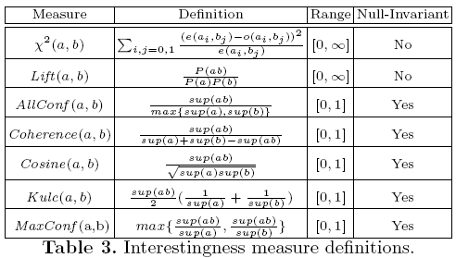
Selecting correlation measure
Two groups of correlation measures
Null-invariant
Expectation-based
Null-(transaction) invariance is crucial for large datasets
T. Wu et al., 2010.
Notes:
First, we select a suitable correlation measure. There are quite a few different correlation measures. The only group of measures which is suitable for large datasets are null-invariant correlation measures.

Slide 16
Challenge with null-invariant measures
Some (Cosine, Kulczynsky) are not anti-monotone
We cannot extract flipping correlations by post-processing all positive and negative correlations, since we cannot compute all positive and negative correlations (see slide 8)
Solution: incorporate flipping constraints into a mining process
Notes:
However, some of these measures (the most useful) are neither monotone, nor anti-monotone, and this poses an additional challenge to the computation of flipping patterns.
We cannot extract flipping patterns by post-processing of all positive and negative correlations, since we cannot compute all positive and negative correlations.
Instead, we push the flipping constraint directly into the mining process, and develop new pruning methods for non-anti monotone measures.

Slide 17
Flipper algorithm: based on three main pruning techniques
Pruning non-flipping itemsets
Termination of the entire pattern growth
Pruning single items and their supersets
Notes:
Our Flipper algorithm is developed for any null-invariant correlation measure and it is based on these three optimizations.
These new pruning techniques lead to a significant reduction of the number of
candidate patterns to be considered in each iteration and to the early termination of the
pattern growth, which accounts for
the high efficiency of our mining algorithm.

Slide 18
1. Pruning non-flipping patterns (I)
If both parent itemset (ab) and child itemset (a₁b₂) have the same correlation sign, then they break a flipping sequence and the children of a₁b₂ cannot be a part of flipping pattern – do not test them
ab
a₁b₁
a₁b₂
a₂b₁
a₂b₂
a₁₁b₁₁
a₁₁b₁₂
a₁₁b₂₁
a₁₁b₂₂
a₂₁b₁₁
a₂₁b₁₂
a₂₁b₂₁
a₂₁b₂₂
a₁₂b₁₁
a₁₂b₁₂
a₁₂b₂₁
a₁₂b₂₂
a₂₂b₁₁
a₂₂b₁₂
a₂₂b₂₁
a₂₂b₂₂

Slide 19
1. Pruning non-flipping patterns (II)
However, a superset of child itemset (a₁₂b₁₂) can still be a part of a flipping pattern, since we cannot predict the correlation value of its superset (not anti-monotone).
ab
abc
a₁b₁
a₁b₂
…
a₁b₁c₁
a₁b₁c₂
…
a₁₁b₁₁
a₁₁b₁₂
a₁₂b₁₂c₁₁
…
a₁₂b₁₂c₂₁
…
a₁₂b₁₁
a₁₂b₁₂
Horizontal pruning not available
a₁₂b₁₂c₁₂
a₁₂b₁₂c₂₂
Vertical pruning if it is not flipping

Slide 20
2. Termination of the Entire Pattern Growth
We prove that for any null-invariant correlation measure, correlation of the superset cannot be larger than the max of correlations of its subsets

Slide 21
2. Termination of the Entire Pattern Growth
If we adding items to itemsets, and we found that all itemsets in two consecutive cells are non-positive, then there are no more flipping patterns because supersets cannot be positively correlated
We can stop our search right there
 |  | k-itemsets
 |  | k=2 | k=3 | … | k=K
Hierarchy level | h=1
 | h=2
 | …
 | h=H-1

Slide 22
3. Pruning single items and their supersets
If all itemsets containing item a₁ are non-positive, and all itemsets containing its generalization item a are non-positive, then item a₁ and all its supersets can be removed from further consideration
 |  | k-itemsets
 |  | k=2 | k=3 | … | k=K
Hierarchy level | h=1
 | h=2
 | …
 | h=H
a
a₁

Slide 23
Order of computation
To utilize these pruning principles, we need to always compare results for two vertically consecutive cells
 |  | k-itemsets
 |  | k=2 | k=3 | … | k=K
Hierarchy level | h=1
 | h=2
 | …
 | h=H
(1) Compute top two levels
(2) Compute level-wise
These are the main ideas of the Flipper algorithm

Slide 24
Outline
Challenge: strong correlations with low support
Flipping correlation pattern
Algorithm for mining flipping correlations
Performance
Real flipping patterns
Conclusion and future work

Slide 25
Performance: Synthetic datasets
Running Time (sec)
Basic support-based
Full Flipper
Flipper scales gracefully with the increase of the number of transactions and the average number of items per transaction

Slide 26
Performance: real datasets
Data Sets
Running Time (sec)
  Basic is not included (ran more than 10 hours for the smallest dataset GROCERIES).
 | # Trans | # Pos | # Neg | # Flips
GROCERIES | 10K | 4.8K | 80K | 174
CENSUS | 32K | 140K | 73K | 232
MEDLINE | 6.4M | 4.2K | 1.6M | 430
Notes:
We extracted flipping patterns from 3 large real-life datasets
The GROCERIES dataset represents 1-month of
the point-of-sale transactions in a local grocery store. The
taxonomy represents item categorization
used in this store
The CENSUS dataset is an extract from the US
Census 1996. It represents multi-attribute records, where
each record characterizes a single person. We considered each record as a transaction. We manually
created hierarchies with two and three levels based on different
attribute combinations.
The MEDLINE dataset is a set of medical paper citations.
Each citation (paper) is a transaction. The items
are the topics. The hierarchy of topics was obtained from
the Medical Subject Headings database
These datasets are dense, and the computation of flipping patterns without using our new pruning techniques is infeasible: we could ran the basic algorithm only for the smallest dataset groceries, which took more than 10 hours, and lead to memory overflow (128 GB RAM). With our new methods, the computation becomes feasible.

Slide 27
Outline
Challenge: strong correlations with low support
Flipping correlation pattern
Algorithm for mining flipping correlations
Performance
Real flipping patterns
Conclusion and future work
Notes:
We discovered numerous surprising flipping correlations from these real datasets. Here we show one example for each dataset.

Slide 28
Flipping patterns: discover incorrectly classified items
Re-design store layouts
Fresh products
Meat & Fish
pork and salad dressing are positively correlated, while in general meat and delicatessen are negatively correlated.
This might suggest removing the salad dressing from delicatessen, and moving it closer to the meat department.
Delicatessen
Meat
Salad dressing
Pork
GROCERIES
Notes:
Each example shows positive or negative correlation between a pair of items at the
most detailed level of abstraction (bottom), accompanied
by the corresponding contrasting correlations between their
abstractions at higher levels.
For example, we can use them to make corrections in a taxonomy tree

Slide 29
Flipping patterns: contrasting sub-populations
Discover sub-populations with a distinct behaviour
Prof:
Craft-repair
Income:
≥50 K
People working in Craft-repair and having Bachelor degree are positively correlated with high income, unlike all people working in Craft-repair
Education matters
Prof:
Craft-repair
&
Edu:
Bachelor
Income:
≥50 K
CENSUS
Notes:
We can discover sub-populations with a distinct behavior

Slide 30
Flipping patterns: under-represented item combinations
Suggest under-represented research topic combinations
Psychological phenomena
Behavioral disciplines
This pattern suggests the collaboration between two unrelated areas of psychophysiology and psychotherapy.
However, if one decides to study the combination of such sub-topics as biofeedback and behavior therapy, he finds out that these two are in fact often studied together.
Psycho
physiology
Psycho
therapy
Psycho
physiology: Bio feedback
Psycho
therapy: Behavior therapy
MEDLINE
Notes:
We can find under-represented research topic combinations.

Slide 31
Flipping patterns in real datasets
Psychological phenomena
Behavioral disciplines
Fresh products
Meat & Fish
Prof:
Craft-repair
Income:
≥50 K
Delicatessen
Meat
Psycho
physiology
Psycho
therapy
Prof:
Craft-repair
&
Edu:
Bachelor
Income:
≥50 K
Psycho
physiology: Bio feedback
Psycho
therapy: Behavior therapy
Salad dressing
Pork
GROCERIES
CENSUS
MEDLINE
Notes:
Flipping patterns represent new interesting knowledge, which was unavailable by using alternative mining techniques

Slide 32
Outline
Challenge: strong correlations with low support
Flipping correlation pattern
Algorithm for mining flipping correlations
Performance
Real flipping patterns
Conclusion and future work

Slide 33
Summary
Introduced the notion of a flipping correlation pattern.
Developed the Flipper algorithm for mining these patterns.
Algorithm is based on flipping constraints and mathematical properties shared among all null-invariant correlation measures
Demonstrated the high efficiency of Flipper in experiments with low support thresholds
Have shown that interesting new patterns can be extracted using the flipping pattern concept.
Notes:
In this paper we
Introduced the notion of a flipping correlation pattern.
Developed the Flipper algorithm for mining these patterns.
The algorithm is based on flipping constraints and mathematical properties shared among all null-invariant correlation measures
We demonstrated the high efficiency of Flipper in experiments with low support thresholds
We have shown that interesting new discoveries can be made by applying the flipping pattern concept.

Slide 34
Future work
More advanced data structures for improving performance of Flipper
Top-K “most flipping” patterns
Computing a set of all discriminative correlations specific for a given subgroup

Slide 35
Thank you for listening
Please email your questions and suggestions to: mgbarsky@gmail.com

